Slide 1
Chapter 2 HTML
By
Neha More
Lecturer in IT,SBMP

Slide 2
Basic example of HTML:
<!DOCTYPE html> The <!DOCTYPE html> declaration defines this document to be HTML5
<html> The <html> element is the root element of an HTML page
<head> The <head> element contains meta information about the document
<title>Page Title</title> The <title> element specifies a title for the document
</head>
<body> The <body> element contains the visible page content
<h1>My First Heading</h1> The <h1> element defines a large heading
<p>My first paragraph.</p> The <p> element defines a paragraph
</body>
</html>

Slide 3
HTML tags
Element names surrounded by angle brackets:
<tagname>content goes here...</tagname>
HTML tags normally come in pairs like <p> and </p>
The first tag in a pair is the start tag, the second tag is the end tag
The end tag is written like the start tag, but with a forward slash inserted before the tag name
HTML Headings
HTML headings are defined with the <h1> to <h6> tags.
<h1> defines the most important heading.
<h6> defines the least important heading:

Slide 4
HTML Block and Inline Elements
Block-level Elements
A block-level element always starts on a new line and takes up the full width available (stretches out to the left and right as far as it can).
Block elements appear on the screen as if they have a line break before and after them.
For example
<p>, <h1>, <h2>, <h3>, <h4>, <h5>, <h6>, <ul>, <ol>, <dl>, <pre>, <hr />, <blockquote>, and <address> elements are all block level elements.
They all start on their own new line, and anything that follows them appears on its own new line.

Slide 5
Inline Elements:
An inline element does not start on a new line and it only takes up as much width as necessary.
It can appear within sentences and do not have to appear on a new line of their own.
The <b>, <i>, <u>, <em>, <strong>, <sup>, <sub>, <big>, <small>, <li>, <ins>, <del>, <code>, <cite>, elements are all inline elements

Slide 6
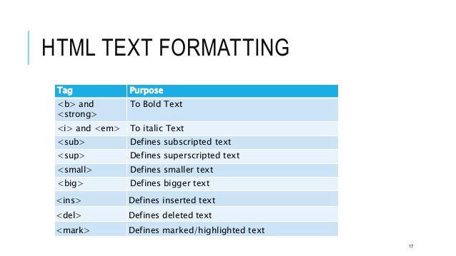
HTML Text Formatting Elements

Slide 7
HTML TEXT FORMATTING
1. The <b> and <strong> tags
The <b> tag is used to write bold text in HTML. The <strong> tag does the same, by adding a bit more emphasis. Simply put, it adds semantic importance to the text.
2. The <i> and <em> tags
The <i> tag is used to make your text italic. The <em> tag does the same, but by giving your italic text, semantic importance.
Basically, both the <em> and <strong> tags appear the same as <i> and <b> on your browser display. However, they don’t mean the same things. One is used for simply making the text italic or bold, the other is used for adding emphasis on the text.
3. The <small> and <big> tags
The <small> tag is used to make the text appear small. The <big> tag does the opposite.
4. The <mark> tag
Another element, which is rarely used but useful all the same. The <mark> tags marks your text with a yellow marker to highlight.

Slide 8
5. The <del> tag
A useful tag for showing removed or deleted text. It displays text with a line crossed through the middle of it.
6. The <ins> tag
Used for displaying inserted or added text. It underlines the text to highlight the fact that its been added in the middle of a line or a paragraph.
7. The <sub> and <sup> tags
The <sub> tag is used for displaying subscripts, the kind that you would probably see in chemical equations. The <sup> script on the other hand, displays the superscripts. Its most commonly used in displaying mathematical equations with power symbols.
8.Strike tag
The HTML <strike> tag gives text the appearance of a strikethrough which draws a horizontal line over the text. This tag is also commonly referred to as the <strike> element.
Note: The <strike> tag has been removed in HTML5. You can try using the <del> tag instead.

Slide 9
HTML comments
This element is used to add a comment to an HTML document.
An HTML comment begins with <!–– and the comment closes with ––>.
HTML comments are visible to anyone that views the page source code, but are not rendered when the HTML document is rendered by a browser.
Note: Comments are not displayed by the browser, but they can help document your HTML source code.

Slide 10
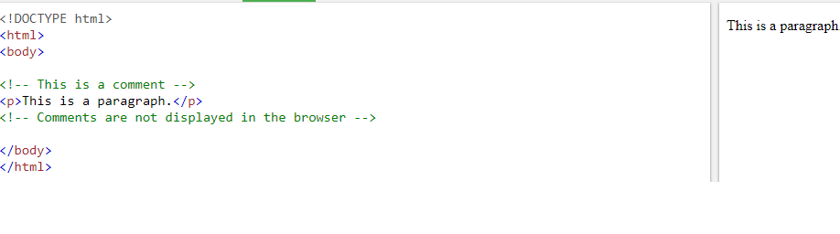

Slide 11
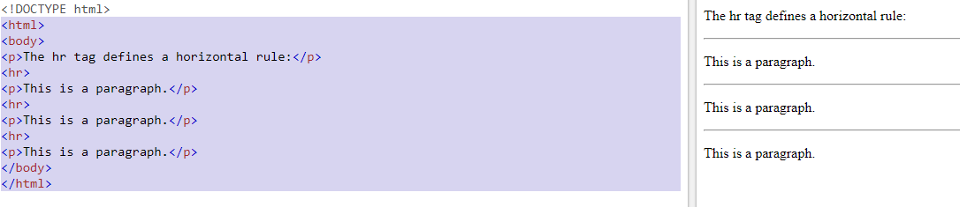
Horizontal row tag
<hr> tag

Slide 12
Meta tag:
additional important information about a document in a variety of ways. The META elements can be used to include name/value pairs describing properties of the HTML document, such as author, expiry date, a list of keywords, document author etc.
The <meta> tag is used to provide such additional information. This tag is an empty element and so does not have a closing tag but it carries information within its attributes.
You can include one or more meta tags in your document based on what information you want to keep in your document but in general, meta tags do not impact physical appearance of the document so from appearance point of view, it does not matter if you include them or not.
Adding Meta Tags to Your Documents
You can add metadata to your web pages by placing <meta> tags inside the header of the document which is represented by <head> and </head> tags.

Slide 13
HTML LISTS
HTML offers web authors three ways for specifying lists of information. All lists must contain one or more list elements. Lists may contain −
<ul> − An unordered list. This will list items using plain bullets.
<ol> − An ordered list. This will use different schemes of numbers to list your items.
<dl> − A definition list. This arranges your items in the same way as they are arranged in a dictionary.

Slide 14
HTML Unordered Lists
An unordered list is a collection of related items that have no special order or sequence. This list is created by using HTML <ul> tag. Each item in the list is marked with a bullet.
<html>
<head>
<title>HTML Unordered List</title>
</head>
<body>
<ul>
<li>Beetroot</li>
<li>Ginger</li>
<li>Potato</li>
<li>Radish</li>
</ul>
</body>
</html>
Output:
Beetroot
Ginger
Potato
Radish

Slide 15
The type Attribute:
You can use type attribute for <ul> tag to specify the type of bullet you like. By default, it is a disc. Following are the possible options −
<ul type = "square">
<ul type = "disc">
<ul type = "circle">

Slide 16
The type Attribute:
<ul type = "square">
html>
<head>
<title>HTML Unordered List</title>
</head>
<body>
<ul type = "square">
<li>Beetroot</li>
<li>Ginger</li>
<li>Potato</li>
<li>Radish</li>
</ul>
</body>
</html>
OUTPUT:
Beetroot
Ginger
Potato
Radish

Slide 17
The type Attribute:
<ul type = "disc">
<html>
<head>
<title>HTML Unordered List</title>
</head>
<body>
<ul type = "disc">
<li>Beetroot</li>
<li>Ginger</li>
<li>Potato</li>
<li>Radish</li>
</ul>
</body>
OUTPUT
Beetroot
Ginger
Potato
Radish

Slide 18
The type Attribute:
<ul type = "circle">
<html>
<head>
<title>HTML Unordered List</title>
</head>
<body>
<ul type = "circle">
<li>Beetroot</li>
<li>Ginger</li>
<li>Potato</li>
<li>Radish</li>
</ul>
</body>
</html>
OUTPUT
Beetroot
Ginger
Potato
Radish

Slide 19
HTML Ordered Lists
OUTPUT
Beetroot
Ginger
Potato
Radish
<html>
<head>
<title>HTML Ordered List</title>
</head>
<body>
<ol>
<li>Beetroot</li>
<li>Ginger</li>
<li>Potato</li>
<li>Radish</li>
</ol>
</body>
</html>

Slide 20
The type Attribute:
<ol type = "1"> - Default-Case Numerals.
<ol type = "I"> - Upper-Case Numerals.
<ol type = "i"> - Lower-Case Numerals.
<ol type = "A"> - Upper-Case Letters.
<ol type = "a"> - Lower-Case Letters.
The start Attribute
<ol type = "1" start = "4"> - Numerals starts with 4.
<ol type = "I" start = "4"> - Numerals starts with IV.
<ol type = "i" start = "4"> - Numerals starts with iv.
<ol type = "a" start = "4"> - Letters starts with d.
<ol type = "A" start = "4"> - Letters starts with D.

Slide 21
HTML Definition Lists
HTML supports a list style which is called definition lists where entries are listed like in a dictionary or encyclopedia.
The definition list is the ideal way to present a glossary, list of terms, or other name/value list.
Definition List makes use of following three tags.
<dl> − (definition list)Defines the start of the list
<dt> − (defne term)A term
<dd> − (definition description)Term definition
</dl> − Defines the end of the list

Slide 22
HTML Definition Lists
<!DOCTYPE html>
<html>
<head>
<title>HTML Definition List</title>
</head>
<body>
<dl>
<dt><b>HTML</b></dt>
<dd>This stands for Hyper Text Markup Language</dd>
<dt><b>HTTP</b></dt>
<dd>This stands for Hyper Text Transfer Protocol</dd>
</dl>
</body>
</html>
OUTPUT:
HTML
This stands for Hyper Text Markup Language
HTTP
This stands for Hyper Text Transfer Protocol

Slide 23
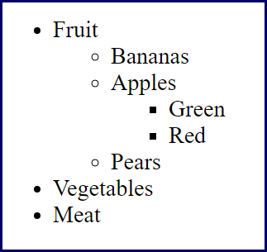
Nested LIST
Example 1

Slide 24
Example 1 Solution
<ul type=‘’disc’’>
<li>Fruit </li>
<ul type=‘’circle’’>
<li>Bananas</li>
<li>Apples </li>
<ul type=‘’square’’>
<li>Green</li>
<li>Red</li>
</ul>
<li>Pears</li>
</ul>
<li>Vegetables</li>
<li>Meat</li>
</ul>

Slide 25
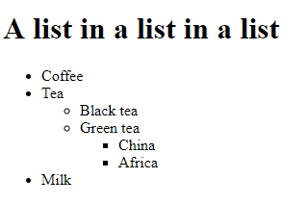
Example 2

Slide 26
Example 2 solution
<html>
<body>
<h1>A list in a list in a list</h1>
<ul>
<li>Coffee</li>
<li>Tea
<ul type="circle">
<li>Black tea</li>
<li>Green tea</li>
<ul type="square">
<li>China</li>
<li>Africa</li>
</ul>
</ul>
<li>Milk</li>
</ul>
</body>
</html>

Slide 27
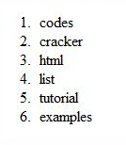
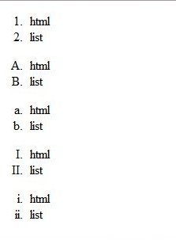
Example 3
Example 4

Slide 28
HTML Links - Hyperlinks
HTML links are hyperlinks.
we can click on a link and jump to another document.
When we move the mouse over a link, the mouse arrow will turn into a little hand.
HTML Links - Syntax
Hyperlinks are defined with the HTML <a> tag:
<a href="url">link text</a>

Slide 29
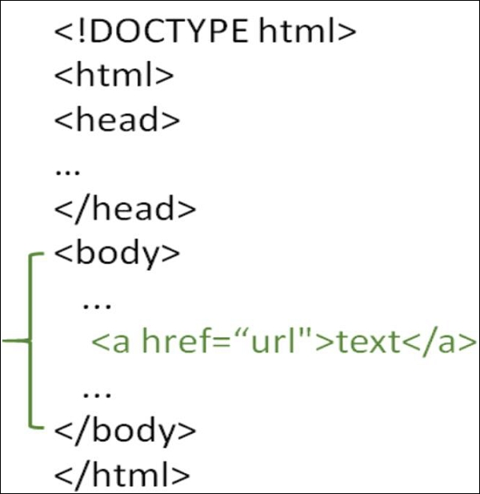
HTML Links - Syntax

Slide 30
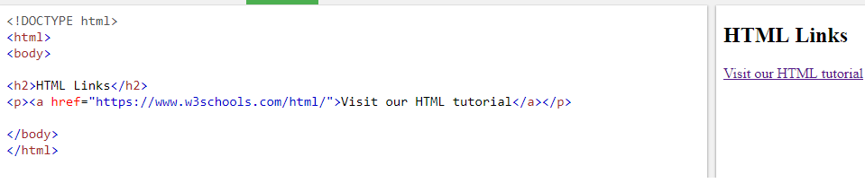
HTML Links - Example
The href attribute specifies the destination address (https://www.w3schools.com/html/) of the link.
The link text is the visible part (Visit our HTML tutorial).
Clicking on the link text will send you to the specified address.

Slide 31
URL:
URL stands for Uniform Resource Locator.
URLs (Uniform Resource Locators) or Resource Locators are unique addresses used to locate a Web page and its contents on a network serve.
Any internet location available on server is called a web URL, web address or website.
Each website or webpage has a unique address called URL.
Types of URL: URL gives the address of files created for webpages or other documents like an image, pdf for a doc file, etc.
There are two types of URL:
Absolute URL
Relative URL

Slide 32
What are Absolute URLs?
Absolute URL requires you to place the entire address on the page that you link to.
An example of an absolute URL would look like this:
<a href = http://www.example.com/xyz.html>

Slide 33
What are Relative URLs?
The relative URL, on the other hand, does not use the full address.
It assumes that the page you type in is on the same site.
An example of a relative URL would look like this:
<a href = "/xyz.html">

Slide 34
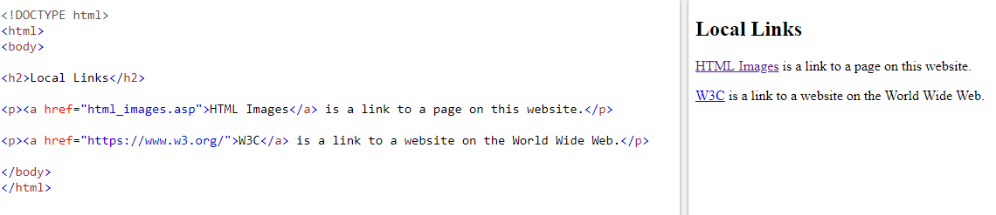

Slide 35
Difference between Absolute and Relative URL:
ABSOLUTE URL | RELATIVE URL
Absolute URL requires you to place the entire address on the page that you link to. | The relative URL, does not use the full address. It assumes that the page you type in is on the same site.
It also referred to as full path. | It also referred to as non absolute path.
Absolute url consumes more time to download files. | Relative url consumes less time to download files.
Example: <a href = http://www.example.com/xyz.html> | Example: <a href = "/xyz.html“>

Slide 36
Target Attribute
The target attribute specifies where to open the linked document:
<a href="https://www.w3schools.com" target="_blank">Visit W3Schools</a>

Slide 37
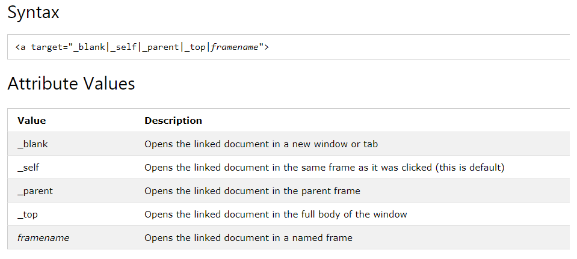

Slide 38
Anchor tag: , Linking To document in folders
Within the same folder, just use the file name:
<a href="thefile.html">my link</a>
Within the parent folder's directory:
<a href="../thefile.html">my link</a>
Within a sub-directory:
<a href="subdir/thefile.html">my link</a>

Slide 39
Anchor Element in HTML
The anchor element is used to create hyperlinks between a source anchor and a destination anchor.
The source is the text, image, or button that links to another resource
The destination is the resource that the source anchor links to.

Slide 40
The Anchor Element
The anchor element tag is the letter “a” surrounded by angle brackets like this: <a>.
Both the opening and closing attributes are required, and all of the content between the tags makes up the anchor source.

Slide 41
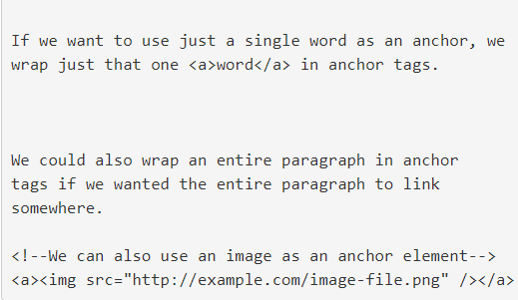

Slide 42
Anchor tag to specific section within the document
HTML bookmarks are used to allow readers to jump to specific parts of a Web page.
Bookmarks can be useful if your webpage is very long.
To make a bookmark, you must first create the bookmark, and then add a link to it.
When the link is clicked, the page will scroll to the location with the bookmark.

Slide 43
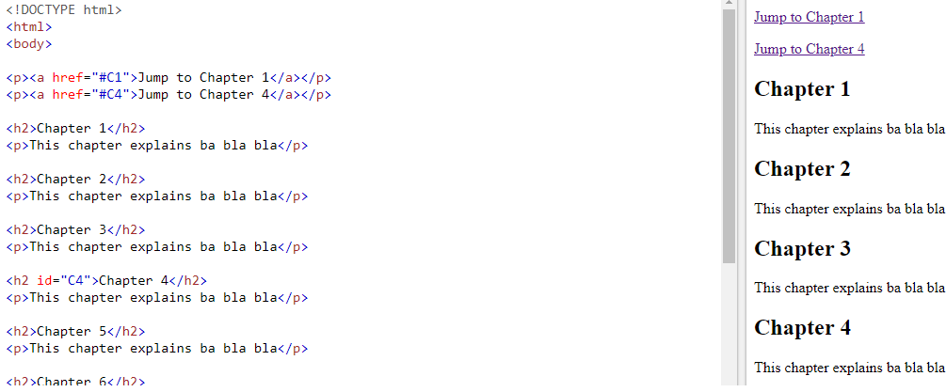
Demo for bookmark

